Slide 1
Android Workshop #5
Making sound
Notes:
24 – Arduino Uno
24 – USB cable
120 – Pushbuttons
120 – 10 kΩ resistors
24 – 150 Ω resistor
24 – Jumper Wire sets
24 – Breadboard
24 – 10 KΩ potentiometer
24 - 8Ω loudspeaker

Slide 2
Understanding speakers

Slide 3
The properties of sound waves
Sound is a pressure wave
An object vibrates the air and the air transferred the energy to your eardrum
Sound has two properties we can control
Amplitude
How far a object vibrates from its resting position
How loud a sound is
Frequency
How quickly the object vibrates
the pitch of the sound
A pure frequency is a sine wave
Arduinos (excluding the Due) can not
How we are going to control
amplitude
Change the amount of current through a speaker
Pitch
Change the frequency of the pulse to the speaker

Slide 4
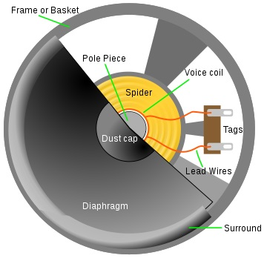
How a speaker works
A speaker is much like a motor
A permanent magnet behind the voice coil and a metal rod inside the coil
change the current in the coil and the rod moves (due to induction)
Oscillate the changes and you get a vibration
Its attached to the diaphragm
The diaphragm vibrates the air and we hear this as sound
Side note: same concept that rings your doorbell

Slide 5
Using tone() to make sound
tone() is a function that produces square waves
It accepts three arguments
Sets pin to generate the tone on
Sets the frequency of the tone
(optional) sets the duration of the tone
If not set - tone plays continuously until you call noTone()

Slide 6
To play music
A map of frequency to notes is useful
Arduino has this in its libraries
We will need to do some work to use it in our code
Download the pitch file (note the location)
Open arduino and save a blank sketch (note the name)
This will save a folder of that name with a .ino file in it
Add the pitch file to the folder you just created
Close arduino IDE and open your .ino file
Two tabs should be present
The pitches.h tab should be a list of mapped frequency to notes
You must include the file in your compiler
#include “pitches.h” -- imports the header files to your code

Slide 7
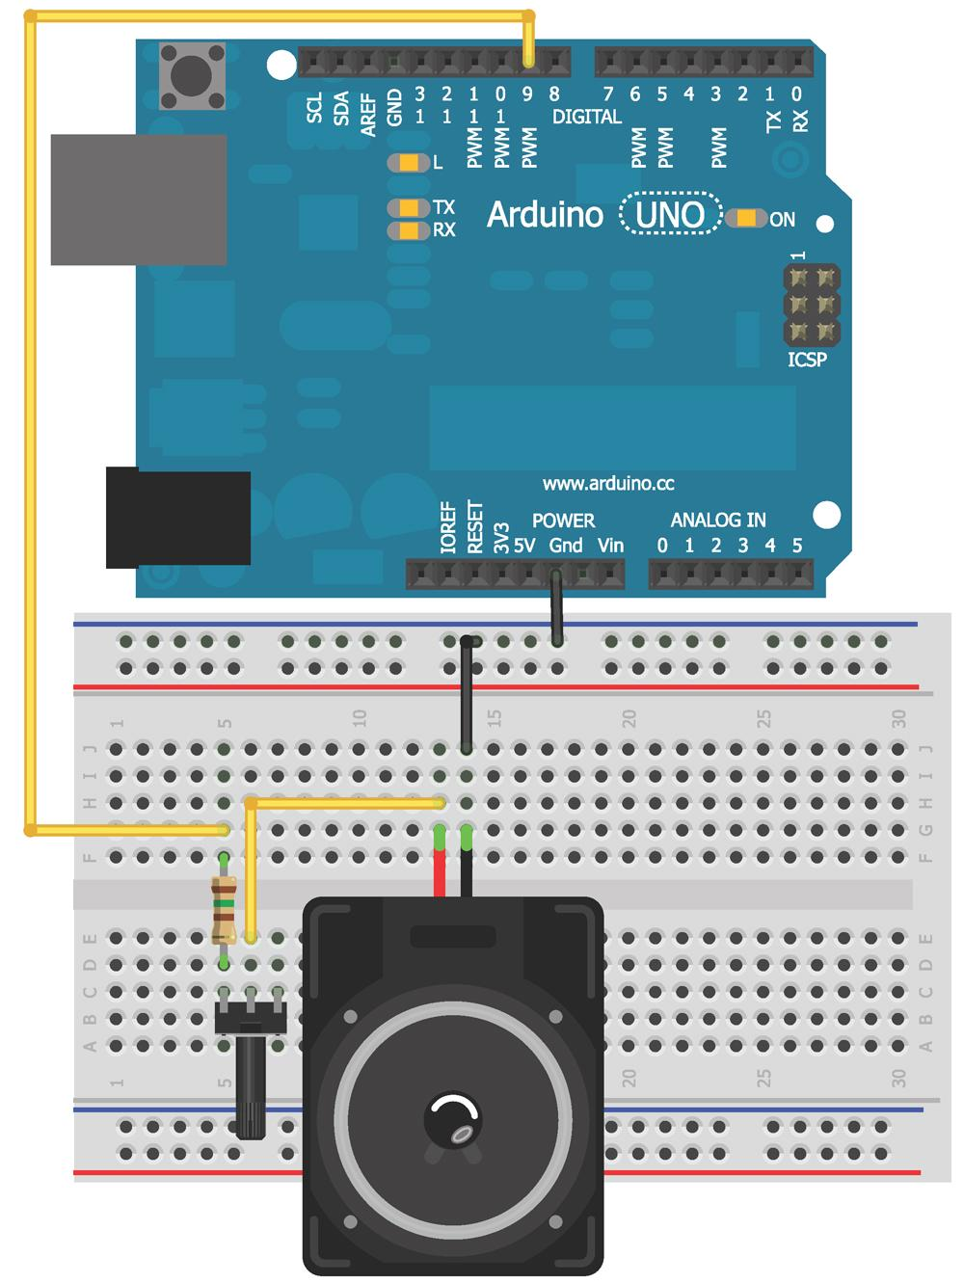
Wiring the speaker

Slide 8
Let's discuss arrays
Arrays are a sequence of values that are related in some way
Think of it as a number list
To ensure arduino memory is properly managed you need to declare an array with a defined length (in one of two ways)
int numbers[4] = {-7,0,6,234};
Int number[] = {-7,0,6,234};
Arrays are 0 indexed
First number in the list is position 0, second is position 1 etc.
You can also store/replace values in a array once initialized
analogWrite(9,numbers[2]) -- sets the reading of pin 9 as the value of the third entry
number[2] = 10; sets the 3rd value of numbers to 10

Slide 9
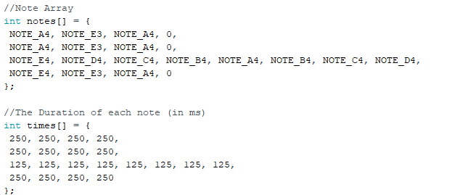
How we can use arrays
If we store two arrays (one with the note to be played in order, one with the length to play that note) we can iterate through them and make music
Note
both arrays are the same size (20 entries)
Some notes are 0
Unplayed beats
In this case ¼ note is 250 ms
This song is in “four-four” time

Slide 10

Here is the sound produced by that array

Slide 11
Adding playback functionality
The last step is to play back the sound
This can be done with a for loop that goes through each index in the array and plays the given note for the given duration

Slide 12
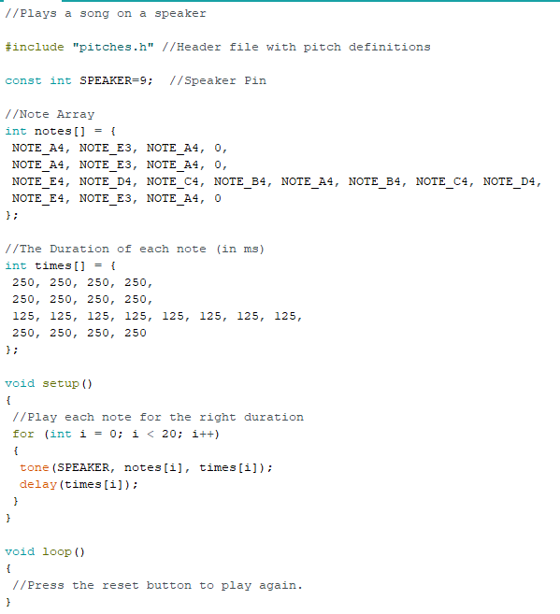
How that code looks

Slide 13
Limitations of tone()
tone() relies on a hardware timer that also is used by the boards PWM functionality
PWM doesnt work right on pins 3 and 11 if you use tone()
Arduino I/O pins are not DACs
They out put only square waves
Fine to make tones but not to listen to music on
You can nonly use tone() on one pin at a time
You need extra code (we will discuss later) to drive multiple speakers

Slide 14
Building a micro piano
As a wrap up we will build a simple pentatonic scale piano
a pentatonic has 5 notes
root,2nd,3rd,5th,6th
the separation of the black keys on a piano
We need to wire 5 buttons with 10 ㏀ pull down resistors
And will use our wired speaker (from earlier)

Slide 15
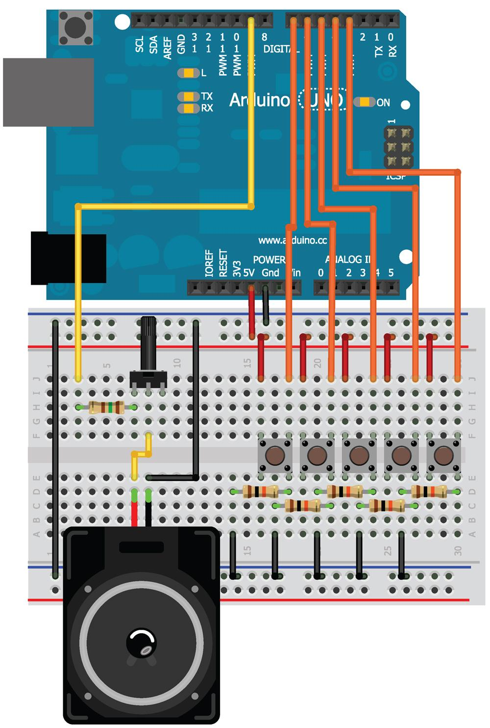
Wiring diagram

Slide 16
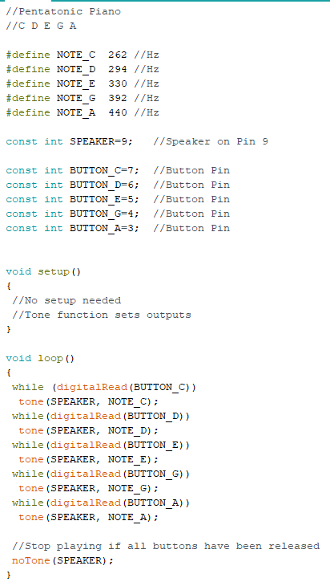
The code

Slide 17
Songs you should be able to play
Many popular songs on a pentatonic scale include:
Amazing Grace – John Newton
Cotton Eyed Joe – Rednex
Swing Low Sweet Chariot
My Girl – The Temptations
Sunshine Of Your Love – Cream
Stairway To Heaven – Led Zeppelin*
Another Brick In The Wall, Pt. 2 – Pink Floyd
Auld Lang Syne – Robert Burns
RING AROUND THE ROSIE
Old Mac Donald had a farm
La fille aux cheveux de lin (The girl with the flaxen hair) – Claude Debussy
Mother Goose – Maurice Ravel
Rain, rain go away
Which can you play by ear?

